Slide 1
SQL Project
Student Marks Analysis

Slide 2
We have the following table
Class9: This table contains field is name,id,maths_marks,History_marks,Science_marks,Social_science_marks,marathi_marks,english_marks
Class10: This table contains field is
name,id,maths_mark,History_mark,Science_mark,Social_science_mark,marathi_mark,english_mark,Hindi_mark,sirname

Slide 3
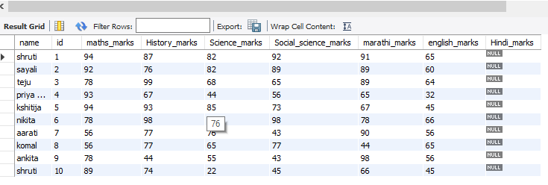
create table class9(name varchar(12),id int,maths_marks int,History_marks int,Science_marks int,Social_science_marks int,marathi_marks int,english_marks int,Hindi_marks int)
insert into class9(name,id,maths_marks,History_marks,Science_marks,Social_science_marks,marathi_marks,english_marks)values("shruti",1,94,87,82,92,91,65),("sayali",2,92,76,82,89,89,60),("teju",3,78,99,68,65,89,64),("priyanka",4,93,67,44,56,65,32),('kshitija',5,94,93,85,73,67,45),("nikita",6,78,98,76,98,78,66),("aarati",7,56,77,76,43,90,56),("komal",8,56,77,65,77,44,65),("ankita",9,78,44,55,43,98,56),("shruti",10,89,74,22,45,66,45)
List of values
select * from class9

Slide 4
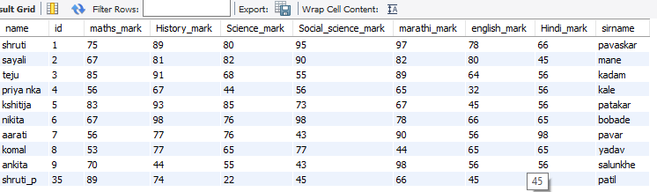
Update name
update class9 set name="shruti_p" where id=10
Select * from class9

Slide 5
create table class10(name varchar(12),id int,maths_mark int,History_mark int,Science_mark int,Social_science_mark int,marathi_mark int,english_mark int,Hindi_mark int)
Add column sirname
alter table class10 add column sirname varchar(12)

Slide 6
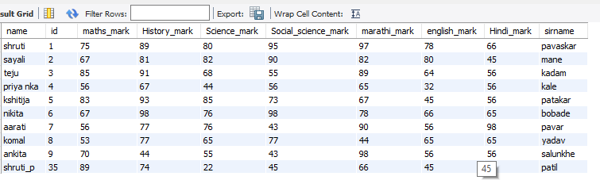
insert into class10(name,id,maths_mark,History_mark,Science_mark,Social_science_mark,marathi_mark,english_mark,Hindi_mark,sirname)values("shruti",1,75,89,80,95,97,78,66,"pavaskar"),("sayali",2,67,81,82,90,82,80,45,"mane"),("teju",3,85,91,68,55,89,64,56,'kadam'),("priyanka",4,56,67,44,56,65,32,56,"kale"),('kshitija',5,83,93,85,73,67,45,56,"patakar"),("nikita",6,67,98,76,98,78,66,65,"bobade"),("aarati",7,56,77,76,43,90,56,98,"pavar"),("komal",8,53,77,65,77,44,65,65,"yadav"),("ankita",9,70,44,55,43,98,56,56,"salunkhe"),("shruti_p",35,89,74,22,45,66,45,66,"patil")
Retrive all data
select * from class10

Slide 7
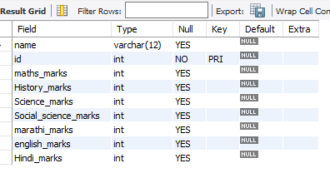
Add constraint
alter table class9 add constraint primary key pk1(id)
alter table class10 add constraint primary key pk2(id)
desc class9

Slide 8
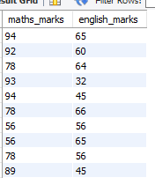
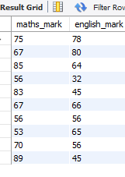
Find maths and English marks in class 10 and 9
select maths_marks,english_marks from class9
select maths_mark,english_mark from class10

Slide 9

Select maths,science marks student shruti 10 nth and 9 nth class
select class9.maths_marks,class9.science_marks,class10.maths_mark,class10.science_mark from class9 join class10 on class9.id=class10.id where class9.name="shruti"

Slide 10
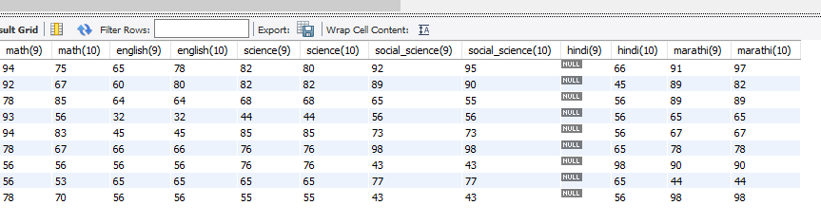
Find students all marks from 10 th and 9 th
select class9.name,class9.maths_marks as "math(9)",class10.maths_mark as "math(10)",class9.english_marks as "english(9)",class10.english_mark as "english(10)",class9.science_marks as "science(9)",class10.science_mark as "science(10)",.social_science_marks as "social_sclass9cience(9)",class10.social_science_mark as "social_science(10)",class9.hindi_marks as "hindi(9)",class10.hindi_mark as "hindi(10)",class9.marathi_marks as "marathi(9)",class10.marathi_mark as "marathi(10)" from class9 join class10 on class9.id=class10.id

Slide 11
Find aarati’s all marks from 10 th and 9 th
select class9.name,class9.maths_marks as "math(9)",class10.maths_mark as "math(10)",class9.english_marks as "english(9)",class10.english_mark as "english(10)",class9.science_marks as "science(9)",class10.science_mark as "science(10)",class9.social_science_marks as "social_science(9)",class10.social_science_mark as "social_science(10)",class9.hindi_marks as "hindi(9)",class10.hindi_mark as "hindi(10)",class9.marathi_marks as "marathi(9)",class10.marathi_mark as "marathi(10)" from class9 join class10 on class9.id=class10.id where class9.name="aarati"

Slide 12
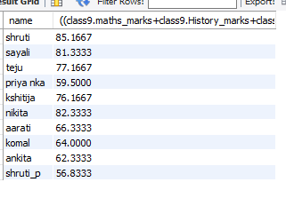
Find student percentage in class 9
select class9.name,((class9.maths_marks+class9.History_marks+class9.Science_marks+class9.Social_science_marks+class9.marathi_marks+class9.english_marks)/600*100) from class9

Slide 13
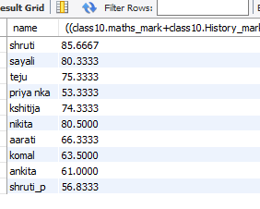
Find student percentage of class 10
select class10.name,((class10.maths_mark+class10.History_mark+class10.Science_mark+class10.Social_science_mark+class10.marathi_mark+class10.english_mark)/600*100) from class10

Slide 14
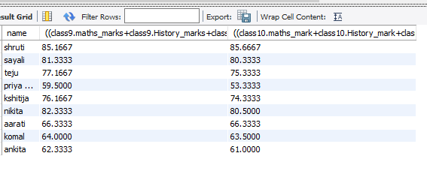
Find student percentage of students of 10 th and9 th
select class9.name,((class9.maths_marks+class9.History_marks+class9.Science_marks+class9.Social_science_marks+class9.marathi_marks+class9.english_marks)/600*100),((class10.maths_mark+class10.History_mark+class10.Science_mark+class10.Social_science_mark+class10.marathi_mark+class10.english_mark)/600*100) from class10join class9 on class10.id=class9.id

Slide 15
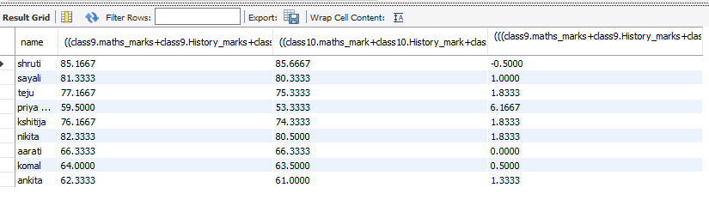
Find student percentage diff between 10 th and 9 th students
select class9.name,((class9.maths_marks+class9.History_marks+class9.Science_marks+class9.Social_science_marks+class9.marathi_marks+class9.english_marks)/600*100),((class10.maths_mark+class10.History_mark+class10.Science_mark+class10.Social_science_mark+class10.marathi_mark+class10.english_mark)/600*100),(((class9.maths_marks+class9.History_marks+class9.Science_marks+class9.Social_science_marks+class9.marathi_marks+class9.english_marks)/600*100)-((class10.maths_mark+class10.History_mark+class10.Science_mark+class10.Social_science_mark+class10.marathi_mark+class10.english_mark))/600*100)from class10join class9 on class10.id=class9.id

Slide 16
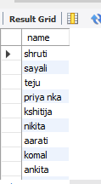
Find students who got less than 35
select name from class10 where(maths_mark)<35 or (History_mark)<35 or (Science_mark)<35 or (Social_science_mark)<35 or (marathi_mark)<35 or(english_mark)<35 or(hindi_mark)

Slide 17
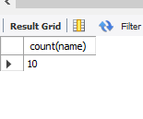
Find no of student
select count(name) from class10

Slide 18
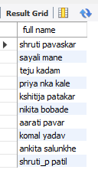
Find student full name
select concat(name," ",sirname) as "full name" from class10

Slide 19
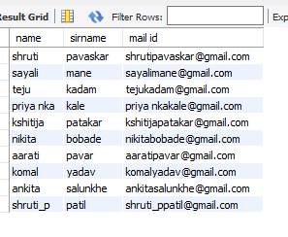
Create students email id using name and sirname
select name,sirname,concat(name,"",sirname,"@gmail.com") as "mail id" from class10

Slide 20

Find student name whose substring hru
select name from class10 where name like "_hru%"

Slide 21
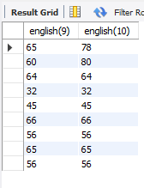
Find student English marks from both standard
select class9.english_marks as "english(9)",class10.english_mark as "english(10)" from class10 join class9 on class10.id=class9.id

Slide 22
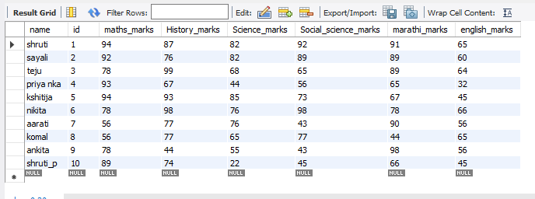
Delete column hindi
alter table class9 drop column hindi_marks
select * from class9

Slide 23

Find student who has less mark in maths in 10 th
select class10.name,class10.maths_mark from class10 order by maths_mark asc limit 1

Slide 24

Find student name whose got higher marks in 10
select class10.name,class10.maths_mark from class10 order by maths_mark desc limit 1

Slide 25

Find student name whose got higher marks in 9
select class9.name,class9.maths_marks from class9 order by maths_marks asc limit 1select class9.name,class9.maths_marks from class9 order by maths_marks desc limit 1

Slide 26
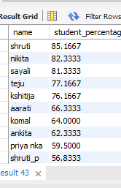
Find student percentage desc order in 9 th std
select class9.name,((class9.maths_marks+class9.History_marks+class9.Science_marks+class9.Social_science_marks+class9.marathi_marks+class9.english_marks)/600*100) as "student_percentage" from class9 order by student_percentage desc

Slide 27
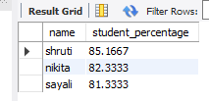
Find student name whose got higher marks in first 3 student in 9 th std
select class9.name,((class9.maths_marks+class9.History_marks+class9.Science_marks+class9.Social_science_marks+class9.marathi_marks+class9.english_marks)/600*100) as "student_percentage" from class9 order by student_percentage desc limit 3

Slide 28

Find student name whose got higher marks in 10 std
select concat(name," ",sirname),((class10.maths_mark+class10.History_mark+class10.Science_mark+class10.Social_science_mark+class10.marathi_mark+class10.english_mark)/600*100) as "student_percentage" from class10 order by student_percentage desc limit 3

Slide 29
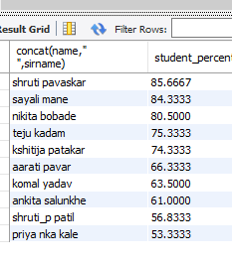
Find student name whose got higher marks in 10 display full name
select concat(name," ",sirname),((class10.maths_mark+class10.History_mark+class10.Science_mark+class10.Social_science_mark+class10.marathi_mark+class10.english_mark)/600*100) as "student_percentage" from class10 order by student_percentage desc

Slide 30

Find student name whose got less marks in 10
select concat(name," ",sirname),((class10.maths_mark+class10.History_mark+class10.Science_mark+class10.Social_science_mark+class10.marathi_mark+class10.english_mark)/600*100) as "student_percentage" from class10 order by student_percentage asc limit 1

Slide 31

Find student name whose got less marks in 9 th
select class9.name,((class9.maths_marks+class9.History_marks+class9.Science_marks+class9.Social_science_marks+class9.marathi_marks+class9.english_marks)/600*100) as "student_percentage" from class9 order by student_percentage asc limit 1

